Slide 1
Charity Funding Predictor
using Deep Learning Neural Network - Report

Slide 2
Overview
For this assignment, our goal was to create an algorithm to predict whether the applicants will be successful in getting funded or not.
We were provided with the input file charity_data.csv which consisted of the following fields:
EIN and NAME—Identification columns
APPLICATION_TYPE—Alphabet Soup application type
AFFILIATION—Affiliated sector of industry
CLASSIFICATION—Government organization classification
USE_CASE—Use case for funding
ORGANIZATION—Organization type
STATUS—Active status
INCOME_AMT—Income classification
SPECIAL_CONSIDERATIONS—Special consideration for application
ASK_AMT—Funding amount requested
IS_SUCCESSFUL—Was the money used effectively
The objective was to identify a model which would have provided an accuracy of 75% or more.

Slide 3
Data Preprocessing
From the input file, following was converted to features, target or removed from the dataframe
EIN and NAME - Removed
APPLICATION_TYPE - Feature
AFFILIATION - Feature
CLASSIFICATION - Feature
USE_CASE - Feature
ORGANIZATION - Feature
STATUS - Feature
INCOME_AMT - Feature
SPECIAL_CONSIDERATIONS - Feature
IS_SUCCESSFUL - Target

Slide 4
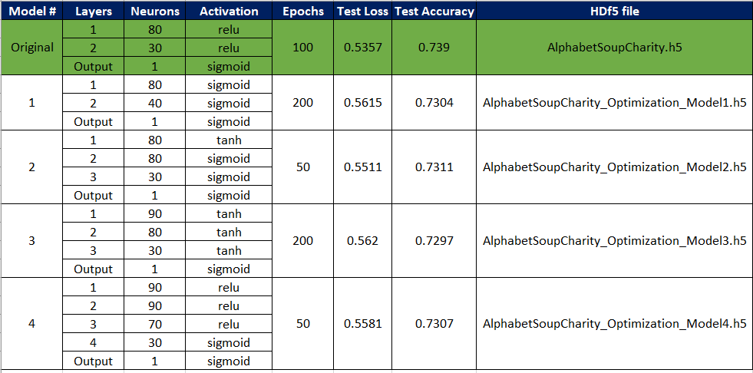
Compiling Training and Evaluating the Model
5 different models were created and following was the outcome

Slide 5
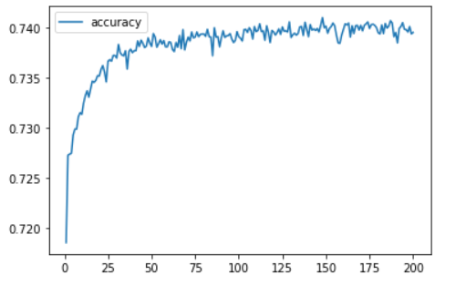
Conclusion
The original model provided the best accuracy
The difference between the original and optimized models was reduction in feature. So, reducing the feature does not always improve the model accuracy
Processing some other columns might have resulted in the desired outcome
For this dataset increasing the Layers or Neurons cause a slight decay with the accuracy but remained within -1% tolerance of the original model
Model 3 was the only model which caused 74% threshold on few occasion with training data, maybe hyper tuning some parameters for this model might have provided desired output of accuracy > 75%

